Slide 1
Adriatic University Montenegro

Slide 2
Adriatic University Montenegro
Faculty for the Mediterranean Business Studies - Tivat
Maritime Faculty – Bar
Faculty for the Mediterranean Business Studies - Ulcinj
Faculty of business and tourism - Budva
Faculty of management - Herceg Novi
Faculty of Business Economics - Bar

Slide 3
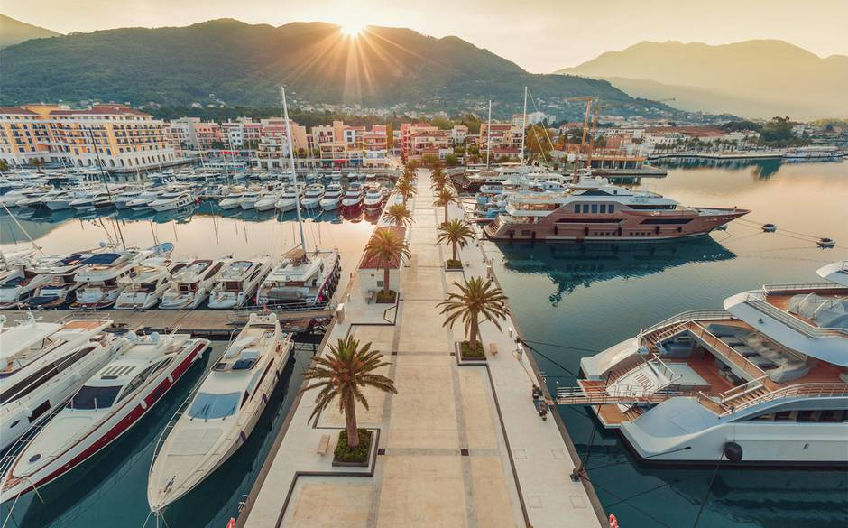
FMS - Tivat Faculty for Mediterranean Business Studies Tivat - Montenegro

Slide 4
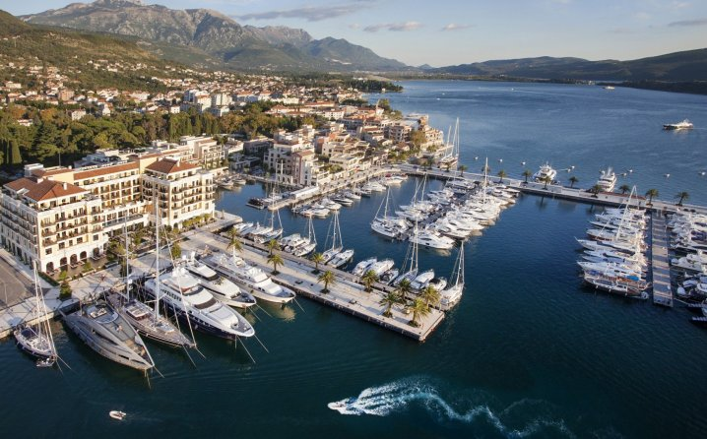
THE FACULTY FOR MEDITERRANEAN BUSINESS STUDIES IS SITUATED in the centre of beautiful mediterranean town TIVAT on the Adriatic sea

Slide 5
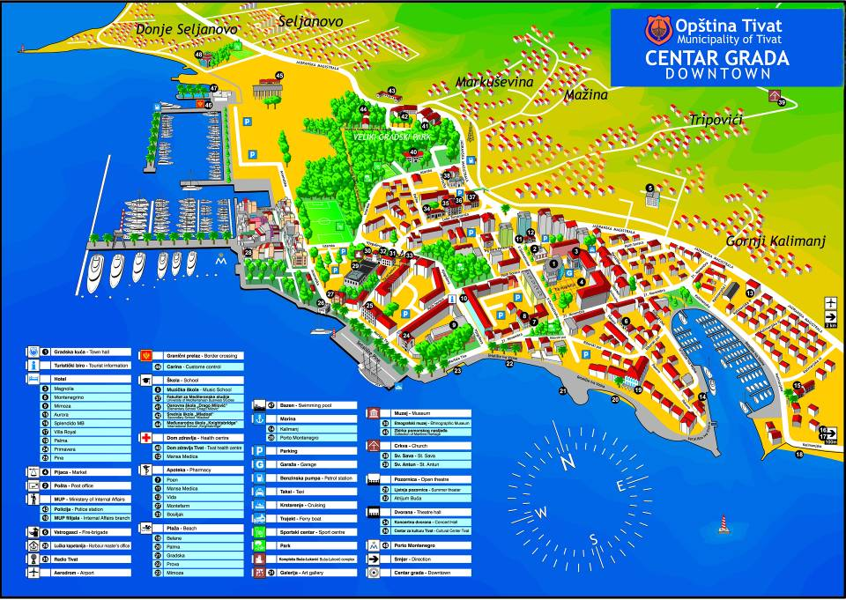

Slide 6
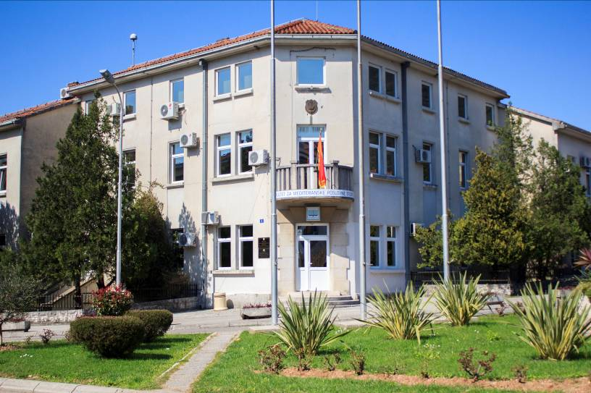
Faculty for Mediterranean Busines Studies Tivat, Montenegro www.fms-tivat.me

Slide 7
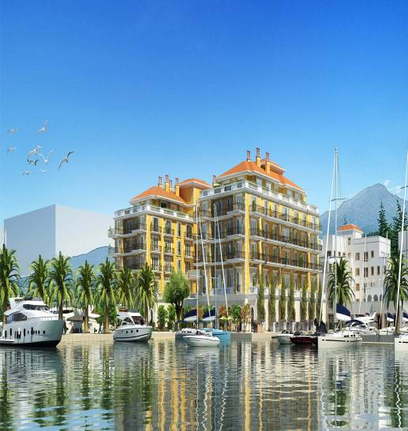
Faculty facts and figures
FIRST AND ONLY FACULTY FOR ACADEMIC STUDIES OF NAUTICAL TOURISM IN THE COUNTRY!
ENROLLMENT OF 10th GENERATION
OF STUDENTS.
OUR STUDENTS HAVE THE OPPORTUNITY FOR EMPLOYMENT IN THE FRAMEWORK OF THE “NEW” NAUTICAL INDUSTRY.
CAREER OPPORTUNITIES IN THE MANAGEMENT OF NAUTICAL TOURISM, MANAGEMENT OF CUSTOMS, AGENCY AND FORWARDING BUSINESS.
JOBS POSSIBILITIES IN THE SECURITY SECTOR, SAFETY AT SEA AND COAST GUARD.

Slide 8
Study programs on the FMS Tivat
Undergraduate study program:
Postgraduate academic Specialist and Master studies:
MANAGEMENT AND SECURITY OF MARINAS AND YACHTS:
MARINAS AND YACHT
SAFETY AND SECURITY AT SEA
2. MANAGEMENT OF CUSTOMS, SHIPPING AND AGENCY BUSINESS
3. MANAGEMENT IN NAUTICAL TOURISM, SPORT AND RECREATION
NAUTICAL TOURISM AND MANAGEMENT OF MARINAS
NAUTICAL TOURISM

Slide 9
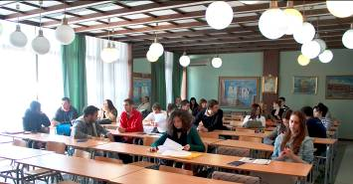
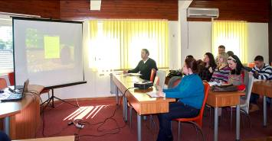
Diploma and Scholarship fees
STUDY PROGRAMS ARE PROFILED ACCORDING TO THE BOLOGNA CONVENTION:
BACHELOR'S DEGREE (BSc/BA)
OF APPROPRIATE STUDY PROGRAM IS A DIPLOMA WHICH IS ACQUIRED AFTER THE COMPLETION OF BASIC ACADEMIC STUDIES
SPECIALIST OF SCIENCE (Spec.Sci)
IS A DIPLOMA WHICH IS ACQUIRED AFTER THE COMPLETION OF POSTGRADUATE SPECIALIST STUDIES
MASTER OF SCIENCE (MSc/MA)
IS A DIPLOMA WHICH IS ACQUIRED AFTER THE COMPLETION OF POSTGRADUATE MASTER STUDIES.
www.fms-tivat.me

Slide 10
Scholarship fees
FOR UNDERGRADUATE STUDIES
1500,00 € (euros)
(FOR ONE YEAR OF
BASIC ACADEMIC STUDIES)
FOR POSTGRADUATE ACADEMIC SPECIALIST STUDIES
1500.00 €
For Master Studies
2000,00 €
FOR POSTGRADUATE
ACADEMIC MASTER STUDIES.
E-BOOKS AND LEARNING MATERIALS ON MOODLE E-LEARNING PLATFORM FOR ALL STUDENTS!

Slide 11
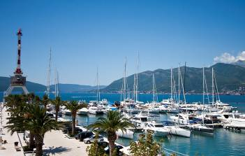
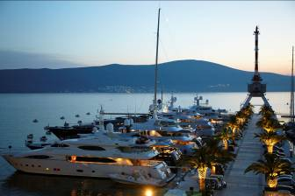
COLLABORATION
SUCCESSFUL
COLLABORATION
WITH
PORTO MONTENEGRO
THE BIGGEST and the Most Luxury
MEGA YACHT
MARINA ON THE
MEDITERRANEAN
http://www.fms-tivat.me

Slide 12
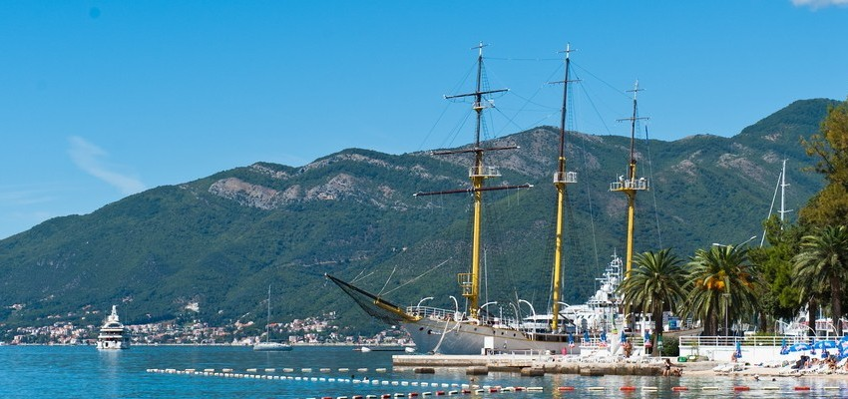
Contact Information
FMS Adress: Faculty for Mediterranean Business Studies Building of Old Municipality of Tivat
Street: Luke Tomanovića number 1
Postal code: 85320
Town: Tivat Country: Montenegro
FMS PHONE NUMBERS: +382 32 671 786 + 382 69 288 045
E - mail: fms-tivat@t-com.me
studentskafms@gmail.com Web: http://www.fms-tivat.me

Slide 13
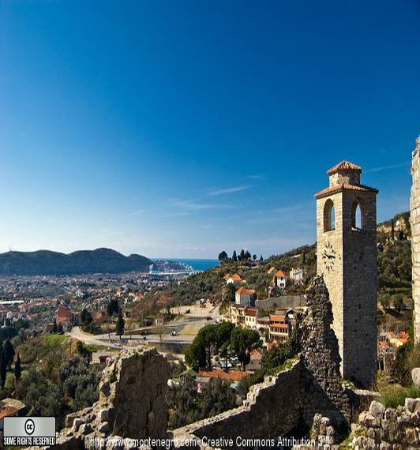
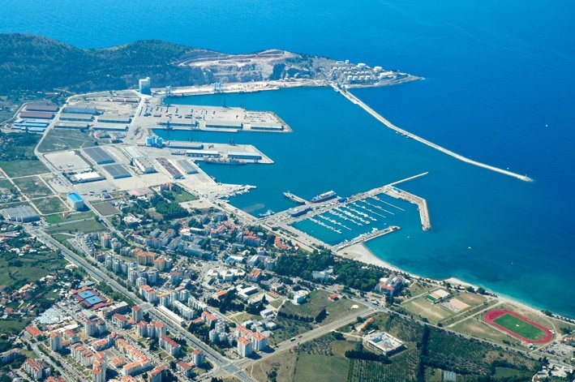
MARITIME FACULTY BAR, Montenegro

Slide 14
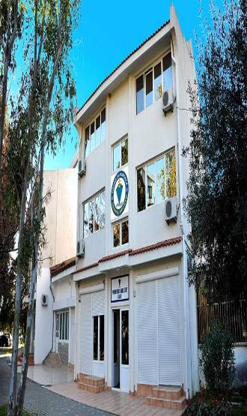
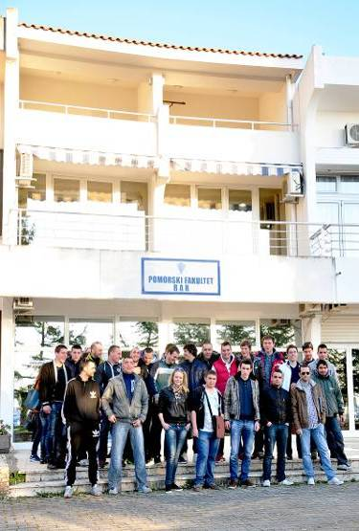
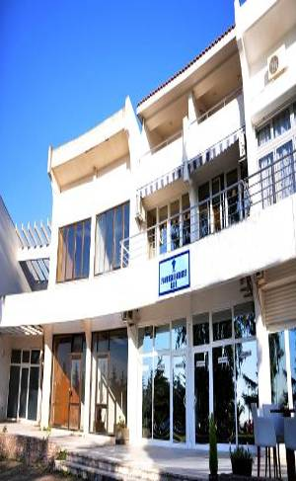
MARITIME FACULTY BAR, Montenegro
www.pfbar.me

Slide 15
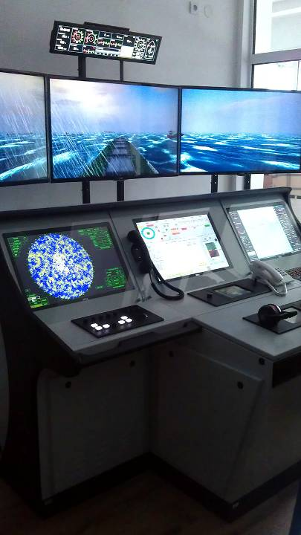
MARITIME FACULTY BAR, Montenegro
THREE ACADEMIC STUDY PROGRAMS:
NAUTICAL SCIENCE
MARINE ENGINEERING
PORT MANAGEMENT

Slide 16
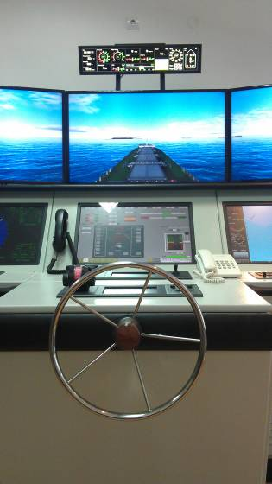
RESOURCES AND FACILITIES
WITHIN THE FACULTY, AS ITS ORGANIZATI-ONAL PART, operates a TRAINING CENTER FOR SAILORS, CERTIFIED BY BUREAU VERITAS REGISTER.

Slide 17
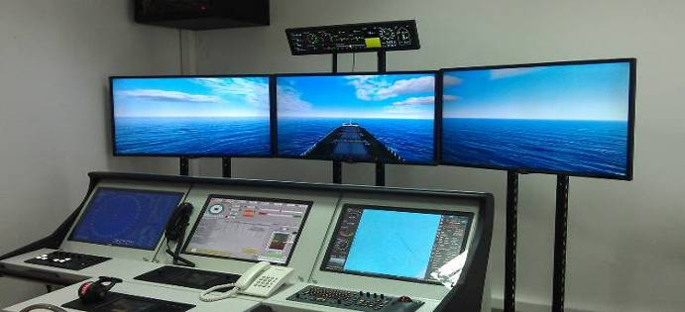
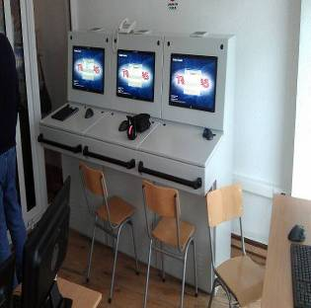
MARITIME TRAINING CENTER
LIVE MARITIME TRAINING EQUIPMENT
2 NAUTICAL SIMULATORS
2 GMDSS SIMULATORS
1 ENGINE ROOM SIMULATORS
Web: http://www.fms-tivat.me

Slide 18
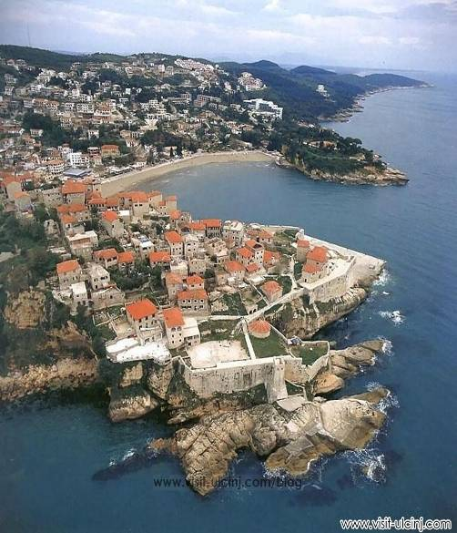
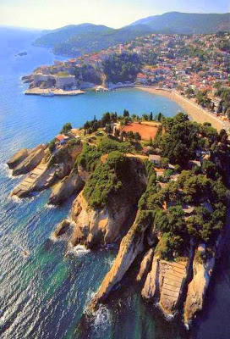
Faculty for Mediterranean business Studies – Ulcinj, Montenegro

Slide 19
Faculty for Mediterranean business Studies – Ulcinj, Montenegro
Study programs
Undergraduate Study programs:
MANAGEMENT AND SECURITY OF MARINAS AND YACHTS:
MARINAS AND YACHTS
SAFETY AND SECURITY AT THE SEA
2. MANAGEMENT OF CUSTOMS, SHIPPING AND AGENCY BUSINESS
3. MANAGEMENT IN NAUTICAL TOURISM, SPORT AND RECREATION
Postgraduate Academic Specialist Studies:
Nautical tourism and management of marinas
Master Studies:
Nautical Tourism

Slide 20
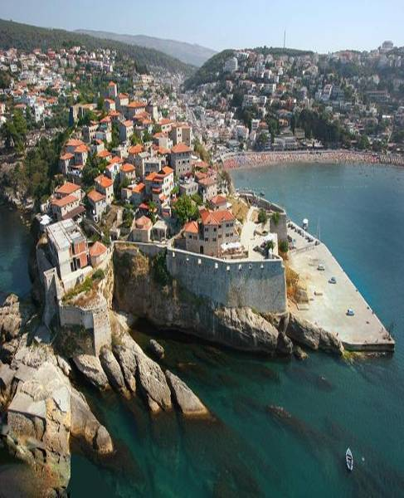
Scholarship fees
FOR UNDERGRADUATE STUDIES
1500 € (euros)
(FOR ONE YEAR OF
BASIC ACADEMIC STUDIES)
FOR POSTGRADUATE ACADEMIC SPECIALIST STUDIES
1500 €
For Master Studies
2000 €
Web: http://www.fms-tivat.me

Slide 21
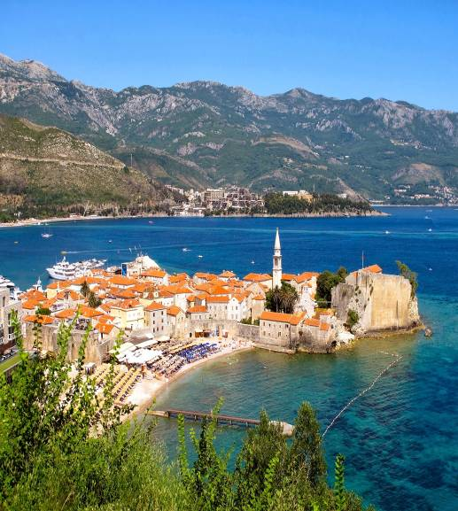
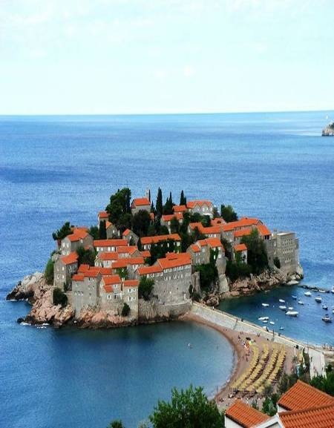
FACULTY OF BUSINESS AND TOURISM – BUDVA, Montenegro

Slide 22
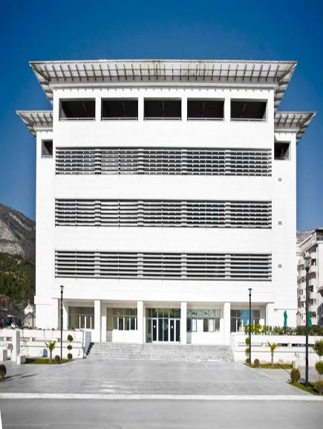
Management in tourism and hospitality
Master Studies – 60 ECTS
Specialist Studies – 60 ECTS
Bachelor Studies – 180 ECTS

Slide 23
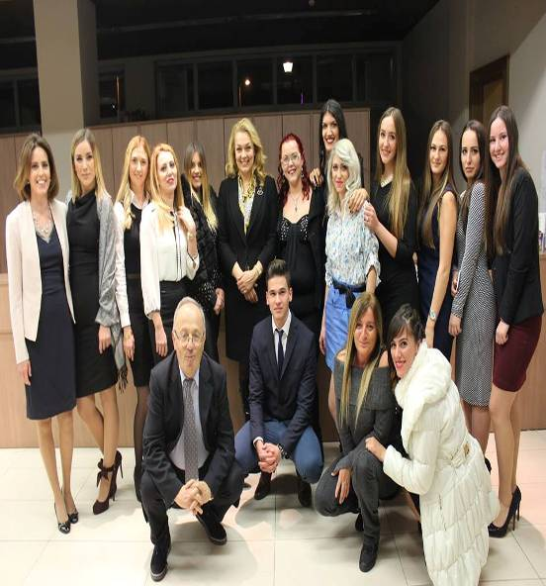
Management in tourism and hospitality
BACHELOR STUDIES
The total annual cost of schooling is € 1,500.00.
SPECIALIST STUDIES
€ 2000.00
MASTER STUDIES
€ 2000.00

Slide 24
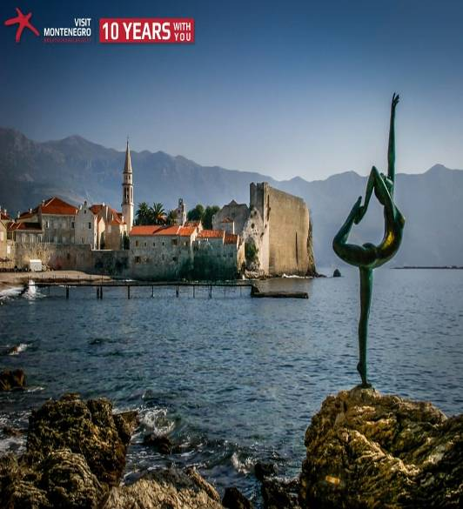
Management in tourism and hospitality
First study program of hospitality management in Montenegro and one of the few in the region
Modern and well-equipped classrooms and amphitheatres
Eminent and experienced professors and experts in tourism practices
Distance Learning System
Internships as an integral part of study program
Development of professional, personal and leadership skills
Visiting lectures
Study visits

Slide 25
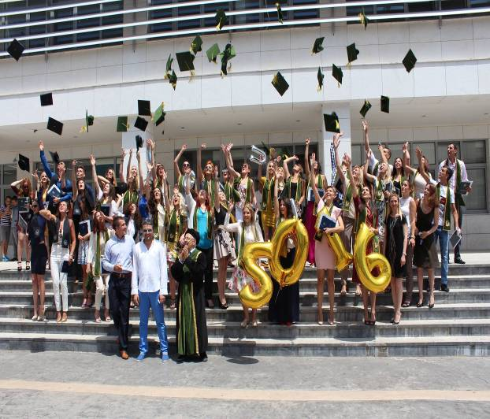
FACULTY OF BUSINESS AND TOURISM – BUDVA, Montenegro
Good balance of general knowledge, professional knowledge and managerial skills makes of our students top managers.

Slide 26
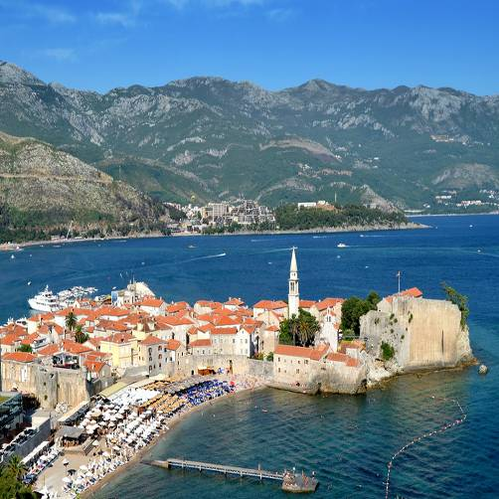
FACULTY OF BUSINESS AND TOURISM – BUDVA, Montenegro
THE RIGHT CHOICE.
THE RIGHT PLACE.
For more information
www.fbt-budva.com
info@fbt-budva.me

Slide 27
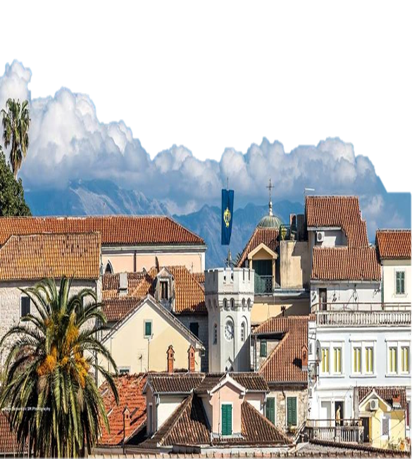
Faculty of management Herceg-Novi, Montenegro
www.fm-hn.com

Slide 28
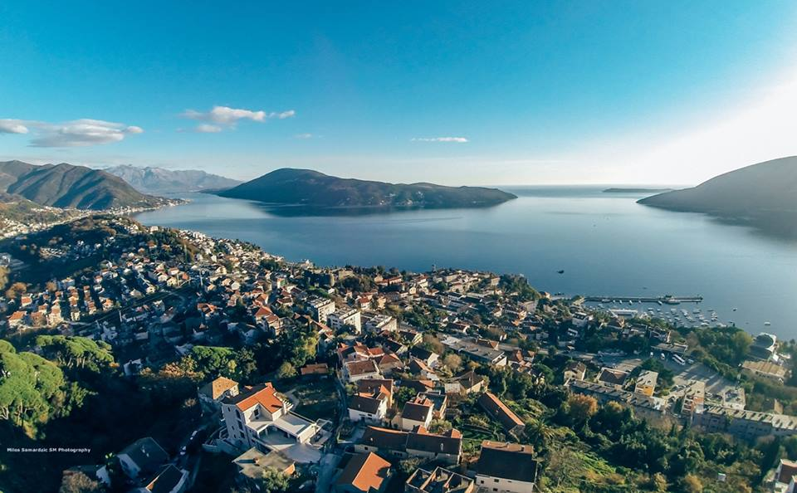
Faculty of Management Herceg-Novi, Montenegro

Slide 29
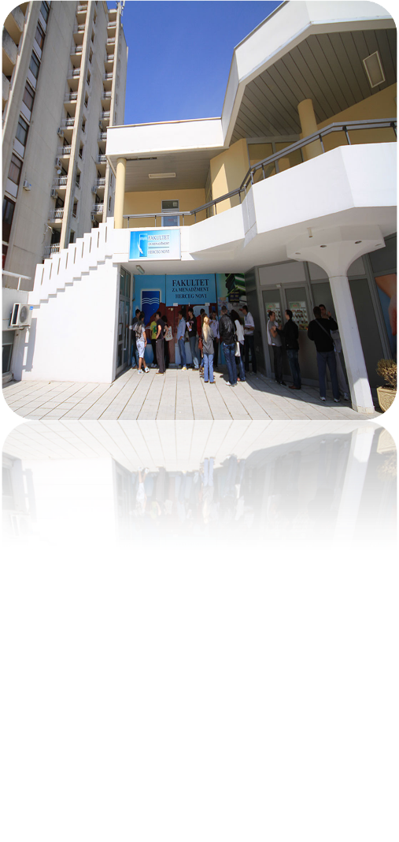
FACULTY OF MANAGEMENT HERCEG NOVI
Contemporary curricula, programs, facilities and equipment are designed according to the highest European standards.
The goal is to empower young people to be competitive in the market and keep place with contemporary tendencies and business trends.
The Faculty curricula is harmonized with the principles of the Bologna Declaration and include the European Credit Transfer System (ECTS).
Teaching staff consists of a team of experts from the country and abroad.

Slide 30
UNDERGRADUATE STUDY PROGRAMS
Faculty is licensed and reaccredited for the contemporary study courses of undergraduate studies in the field of:

Slide 31
POSTGRADUATE STUDY PROGRAMS
Faculty is licensed for the contemporary study courses of postgraduate specialist and master’s studies in the field of Business Management.

Slide 32
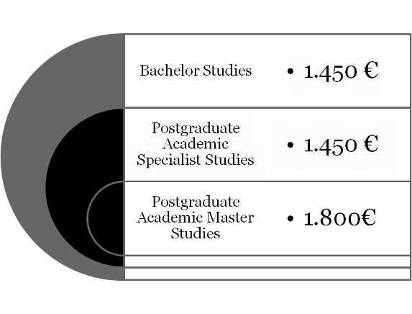
SCHOLARSHIP FEE
Total annual tuition fee per study level:

Slide 33
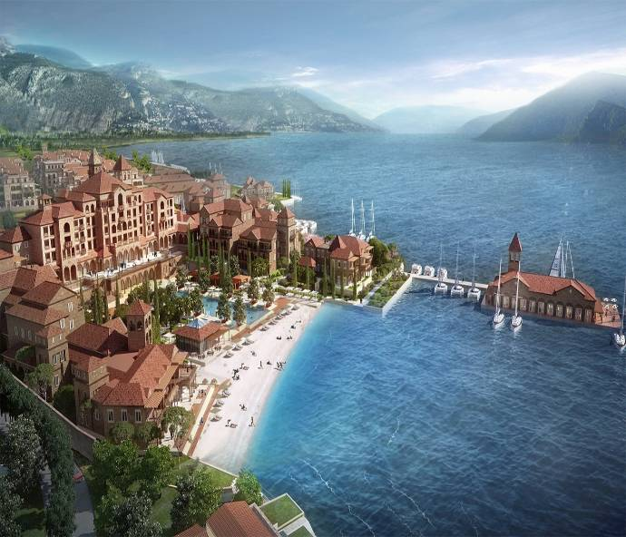
COLLABORATION AND EMPLOYMENT OPPORTUNITIES
Educational profiling is created so that our graduates have the opportunity of employment in major tourism projects in the area of Herceg Novi, such as luxury resorts „Lustica Bay“, „Portonovi“ and „Lazure Marina & Hotel“.

Slide 34
CONTACT INFORMATION
ADDRESS
Faculty of Management,
Norveška 2, Herceg Novi, Igalo
TELEPHONE
+382 31 332 900
E – MAIL
fmhnstudentskasluzba@gmail.com
studentskasluzba@fm-hn.com
WEBSITE
www.fm-hn.com

Slide 35
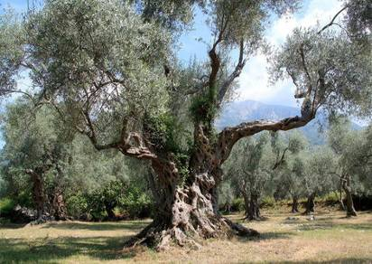
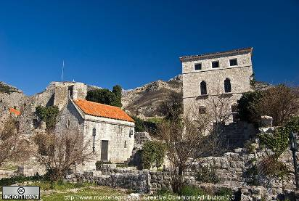
Faculty of Business Economics Bar, Montenegrowww.FPEbar.me

Slide 36
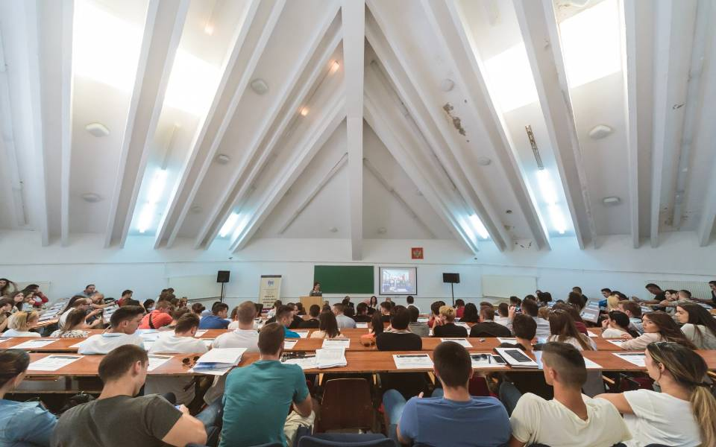
BECOME A PART OF EUROPEAN ACADEMIC FAMILY

Slide 37
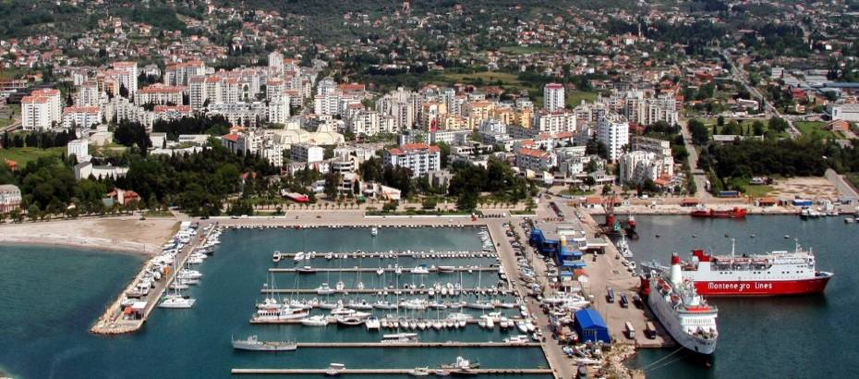
www.FPEbar.me
http://www.visit-montenegro.com/explore/coast/bar

Slide 38
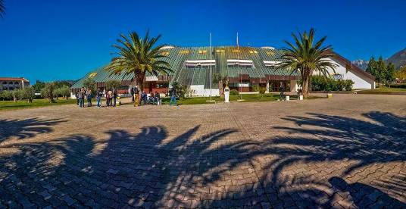
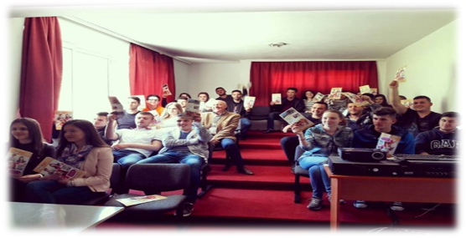
Faculty of Business Economics Bar, Montenegro
Faculty of business economics is independent higher education institution which gained accreditation in 2012. So far, FBE Bar successfully finished process of reaccreditation of bachelor studies – programs such as „Accounting, finances and banking“ and „Management“, accreditations for master studies in programs „Public sector management“ and „Profit sector management“, and also process of self-evaluation by EUA board (IEP project).

Slide 39
Postgraduated academic specialist studies (240 ECTS)
Public sector management
Profit sector management
Postgraduated academic MASTERstudies (300 ECTS)
Public sector management
Profit sector management
Undergraduated study programs (180 ECTS)
Accounting, finanse and banking
Management

Slide 40
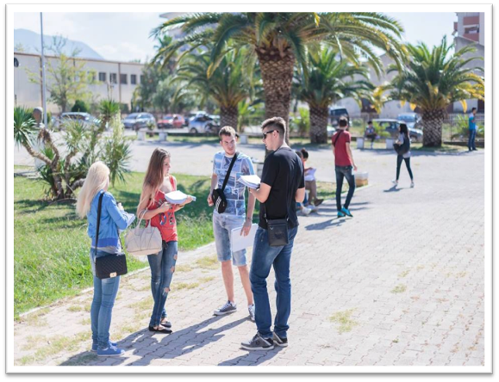
Faculty of Business Economics Bar, Montenegro
Today FBE counts over 500 active students, over 150 already graduated students came out from faculty and large number of them already work in numerous companies, institutions, local administrations, banks. -Every day on faculty, for teaching are responsible respectful professors, assistants and fellow contributors.

Slide 41
Faculty of Business Economics Bar, Montenegro
Undergraduated study programs – 1200 EUR
Postgraduated academic specialist studies – 1700 EUR
Postgraduated academic master studies – 1900 EUR

Slide 42
Faculty of Business Economics Bar, Montenegro
By devoting to principles of Bologna declaration and their implementation, and focusing on practical part of education through development of innovative program of practical learning and student practice, faculty is already recognised and highly respected in region not only by both public and private sector, but also from social community and students. Faculty already gained very active and innovative role in Montenegrin higher education.

Slide 43
Faculty of Business Economics Bar, Montenegro
CONTACT INFORMATIONS
Adress | Bjelisi bb 85000
Town | Bar
Country | Montenegro
Email | FPEbar@gmail.com
Web site | www.FPEbar.me
Social network | www.fb.com/FPEbar

Slide 44
Be a part of the future which has already been profiled and realized as concept : “Montenegro - a nautical tourist destination!”
www.fms-tivat.me

Slide 45
Thank You !
www.fms-tivat.me

